Slide 1
Principles of Data Science
Li Niu

Slide 2
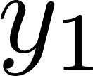
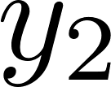


Single-label V.S. Multi-label
…
single-label learning
…
multi-label learning

Slide 3
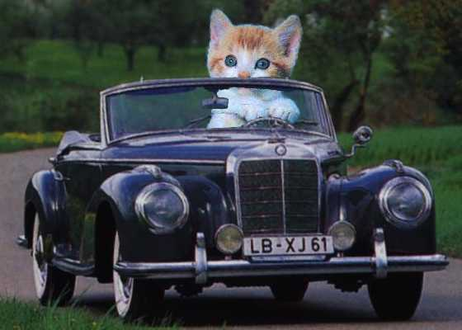



Single-label V.S. Multi-label
…
dog
 | 1 | 0 |  | 0
 | 0 | 0 |  | 1
 | 0 | 1 |  | 0
cat
…
…
…
…
…
…
…
…
bird
…
single-label learning

Slide 4
Single-label V.S. Multi-label
…
car
 | 1 | 1 |  | 0
 | 0 | 1 |  | 1
 | 0 | 1 |  | 0
cat
…
…
…
…
…
…
…
…
bird
…
multi-label learning

Slide 5
Multi-label learning
Convert to binary classification
Convert to multi-class classification

Slide 6


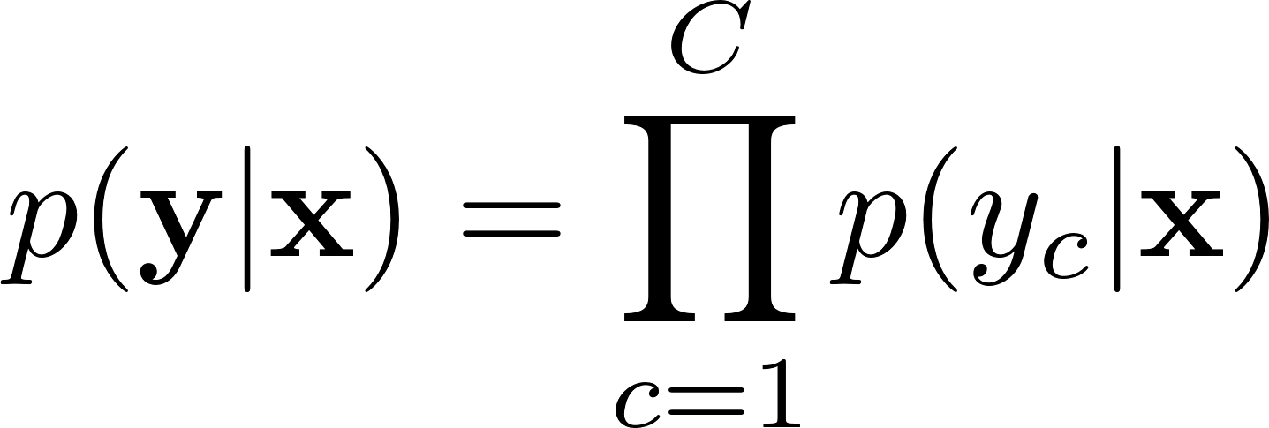
Multi-label learning
…
Assume label independence.

Slide 7
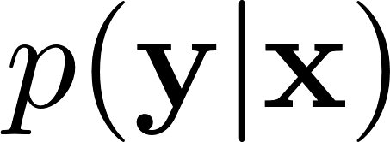
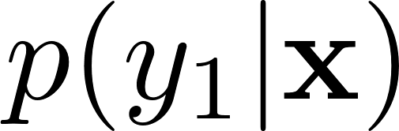
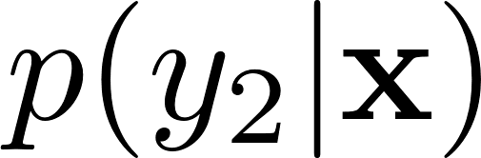
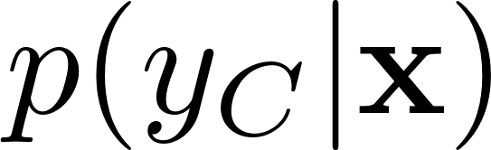
Multi-label learning
…
 | 1 | 1 |  | 0
 | 0 | 1 |  | 1
 | 0 | 1 |  | 0
…
…
…
…
…
…
…
…
separate into C binary classification
 | 1
 | 0
 | 0
 | 1
 | 1
 | 1
 | 0
 | 1
 | 0
…
…
…
…
…
…
…

Slide 8
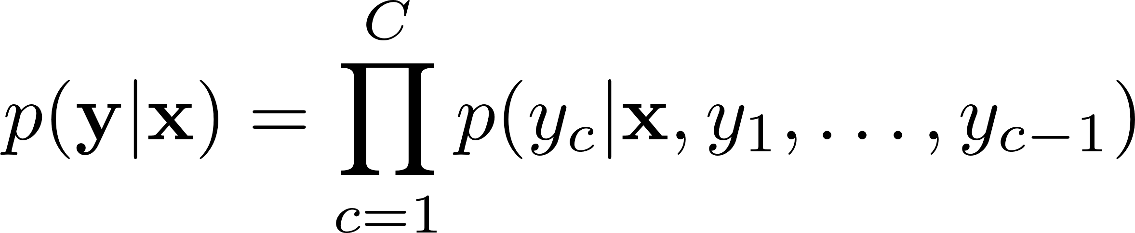
Multi-label learning
…
Consider label dependence.

Slide 9
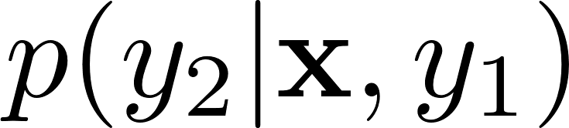
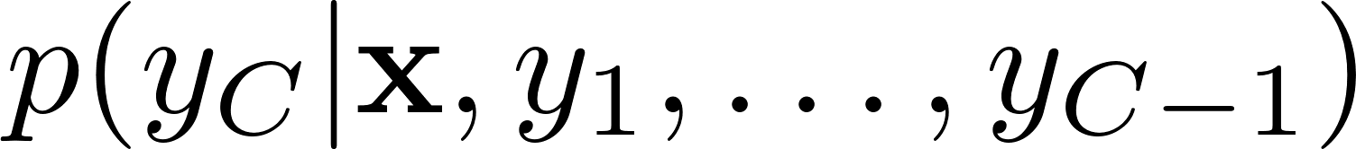
Multi-label learning
…
 | 1 | 1 |  | 0
 | 0 | 1 |  | 1
 | 0 | 1 |  | 0
…
…
…
…
…
…
…
…
Concatenate feature and labels as new feature
 | 1
 | 0
 | 0
 | 1 | 1
 | 0 | 1
 | 0 | 1
…
 | 1 | 1 |  | 0
 | 0 | 1 |  | 1
 | 0 | 1 |  | 0
…
…
…
…
…
…
…
…
…
…
…
…
…
…

Slide 10

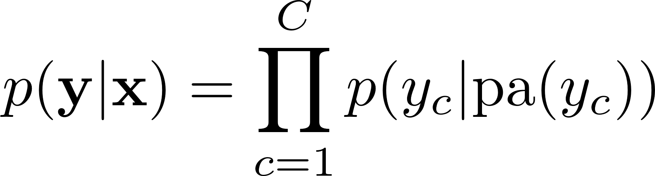
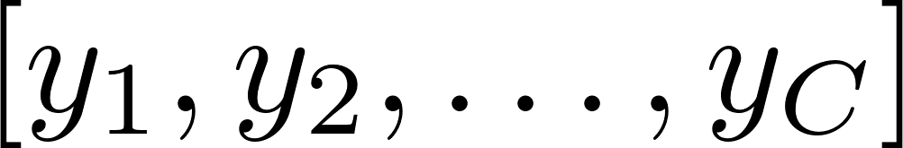
Multi-label learning
…
the set of parent nodes of
As long as form a Directed Acyclic Graph (DAG),
the problem can be solved similarly.

Slide 11
Multi-label learning
Convert to binary classification
Convert to multi-class classification

Slide 12
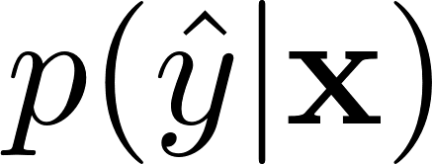
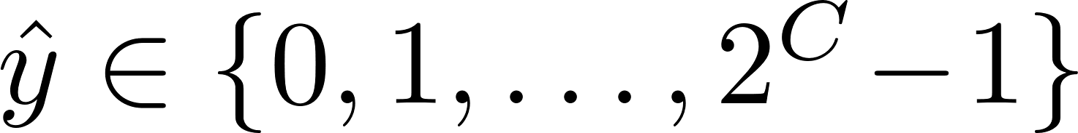

Multi-label learning
Convert to single-label learning, but the number of categories is too large.

Slide 13


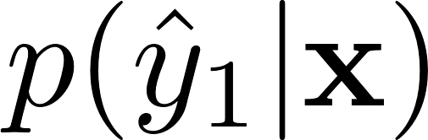
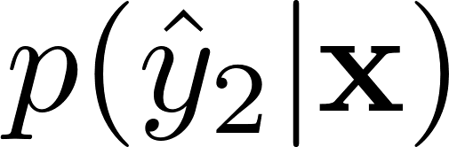
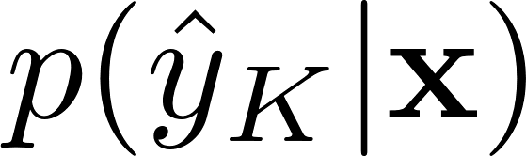
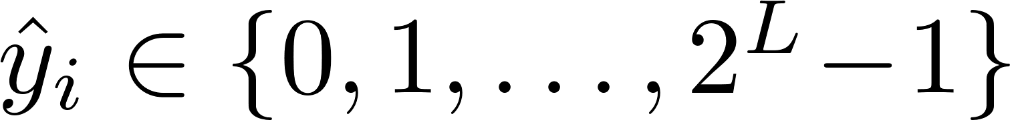
Multi-label learning
Divide categories into groups
with categories in each group.
Different groups can have overlap.
…
ensemble voting
…

Slide 14
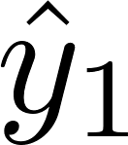
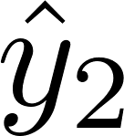
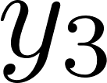
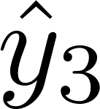
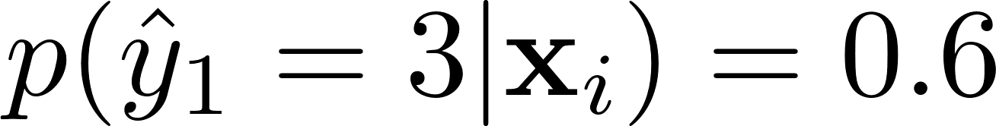
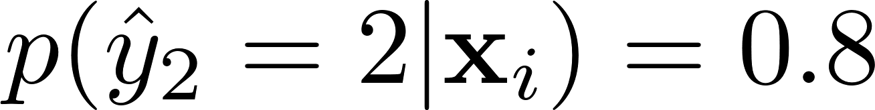
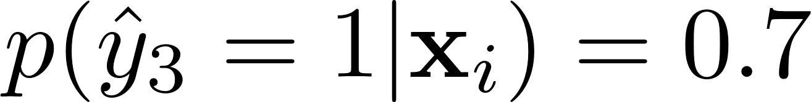
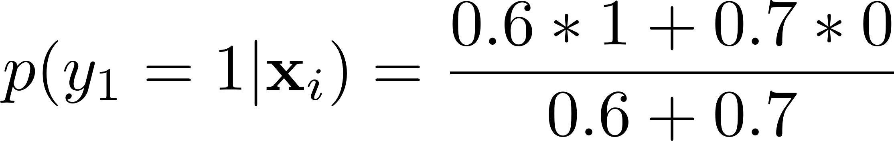
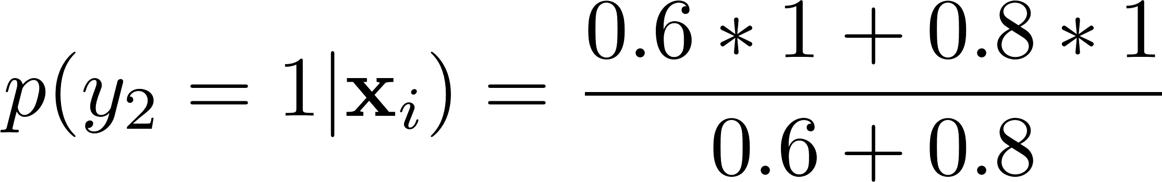
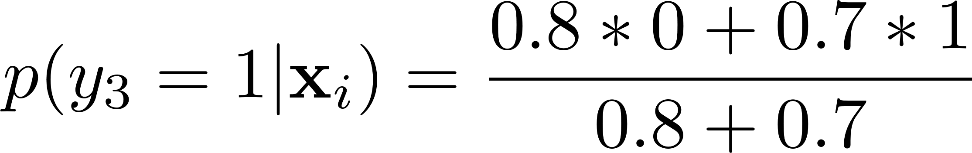
Multi-label learning
An example of ensemble voting
0 | 0 | 0
1 | 0 | 1
2 | 1 | 0
3 | 1 | 1
0 | 0 | 0
1 | 0 | 1
2 | 1 | 0
3 | 1 | 1
0 | 0 | 0
1 | 0 | 1
2 | 1 | 0
3 | 1 | 1
Use threshold 0.5 to determine yes or no

Slide 15
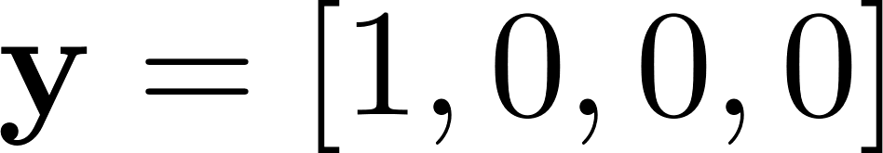
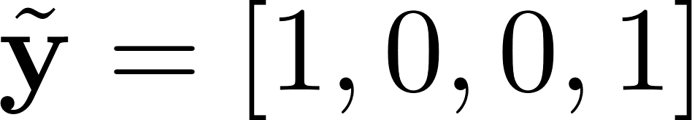
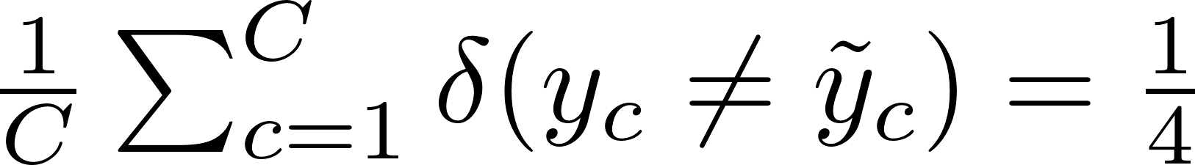
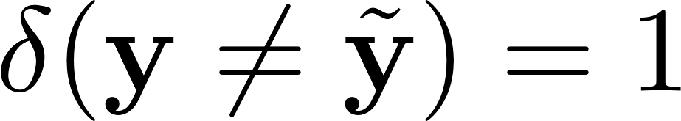
Multi-label evaluation
Ground-truth label vector
Predicted label vector
Hamming loss:
0/1 loss:

Slide 16

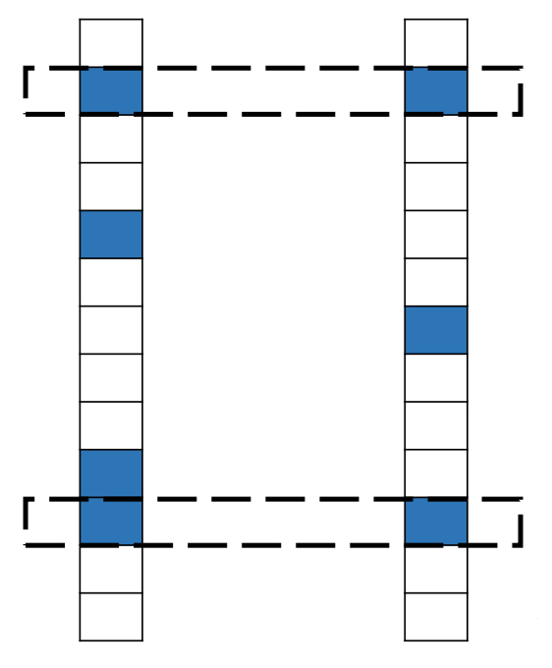
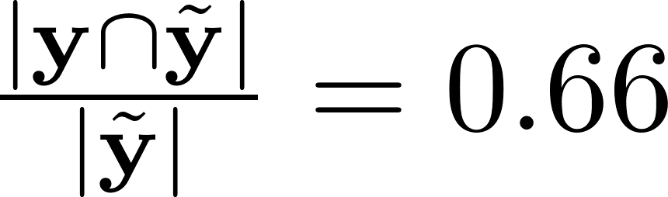
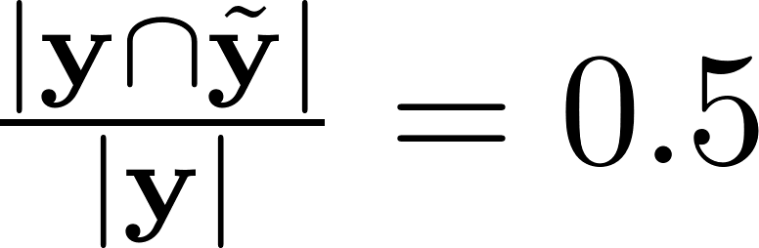
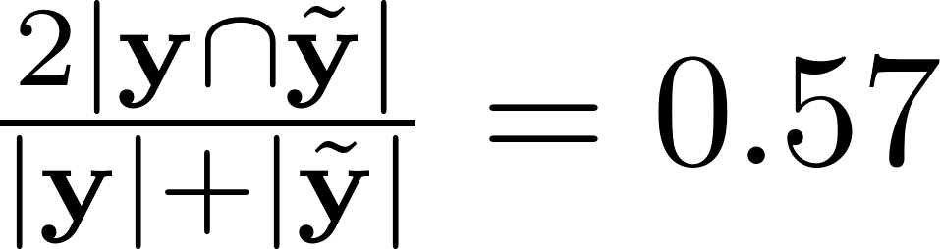
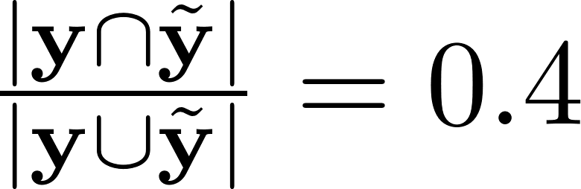
Multi-label evaluation
ground-truth
predicted
precision
recall
F-measure
Jaccard distance

Slide 17
Thanks!

